Slide 1



7. Clicking fingers
Snapping one’s fingers results in a loud popping sound. Investigate the nature and properties of this sound.
Rep:$Nikoloz Burduli$

Slide 2
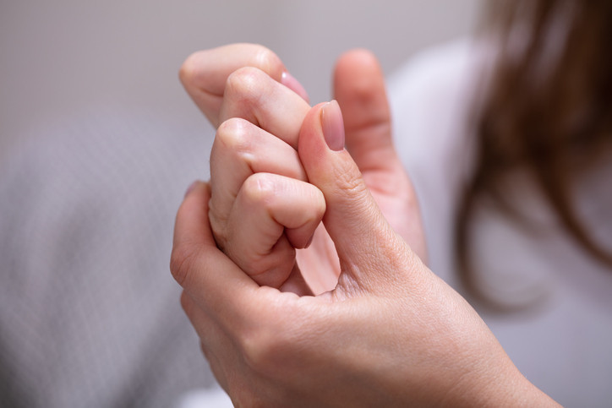
Presentation plan
What is synovial fluid;
Why is popping sound heard;
Resonant frequency;
Theoretical result;
Experimental result;
Conclusion.
Notes:
”. First of all, I will introduce to you the presentation plan. We will discuss what synovial fluid is and why it is needed; Why is popping sound heard; What is resonant frequency; I will show you theoretical and experimental results and finally we will make a conclusion.

Slide 3
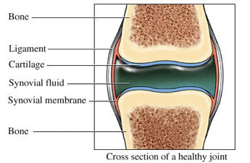
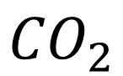
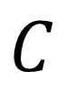

Fluid between the bones
Bone
$$N$$
Ligament
Cartilage
$$C$$
Synovial fluid
Synovial membrane
Bone
$${CO}_{2}$$
Explanation of the fact
Theoretical model
Experiment
Conclusion
Notes:
The synovial fluid is a fluid, which is between the bones, secondly it is called joint fluid. This thick liquid cushions the ends of bones and reduces friction when you move your joints. Synovial fluid is located in the synovial membrane. Inside the fluid is a variety of gases including nitrogen, oxygen and carbon dioxide. Fluid contains the largest amount of carbon dioxide.

Slide 4
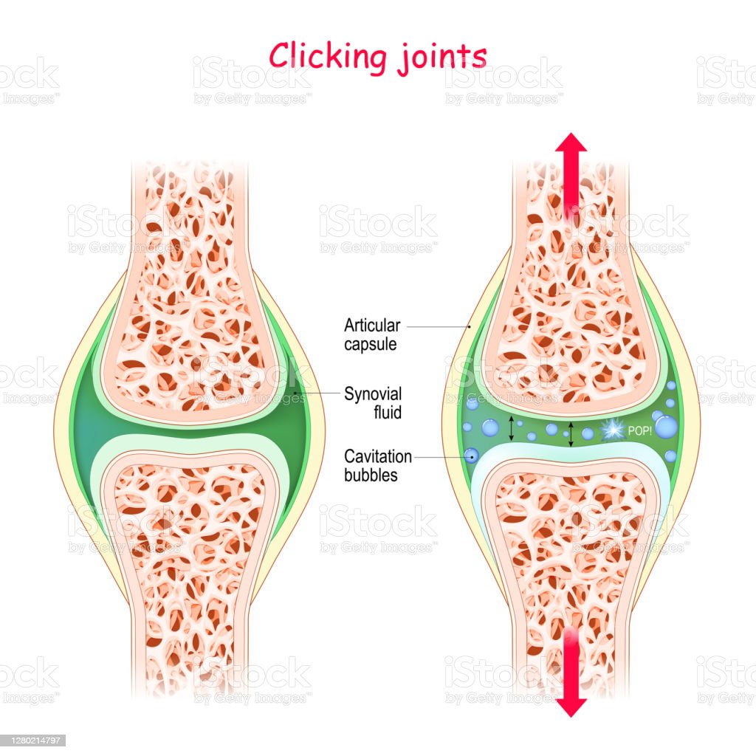
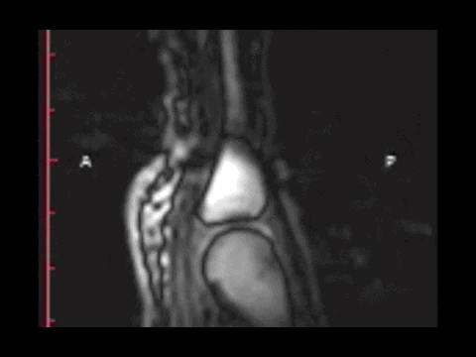
Explanation of the phenomenon
Explanation of the fact
Theoretical model
Experiment
Conclusion
Notes:
When we act on the finger with any force, the two bones move away from each other at a certain distance, thus increasing the volume of the synovial membrane, thus reducing the pressure. Because of the reduction of the pressure, air bubbles in the synovial fluid are formed and expanded. Finally, the sound we call popping is the sound of this bubble bursting. On the right you can see the video of this popping taken by X-ray machine.

Slide 5
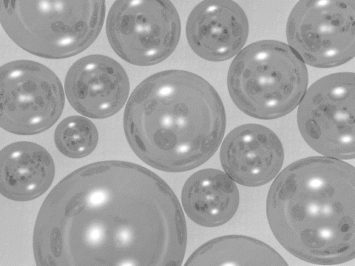
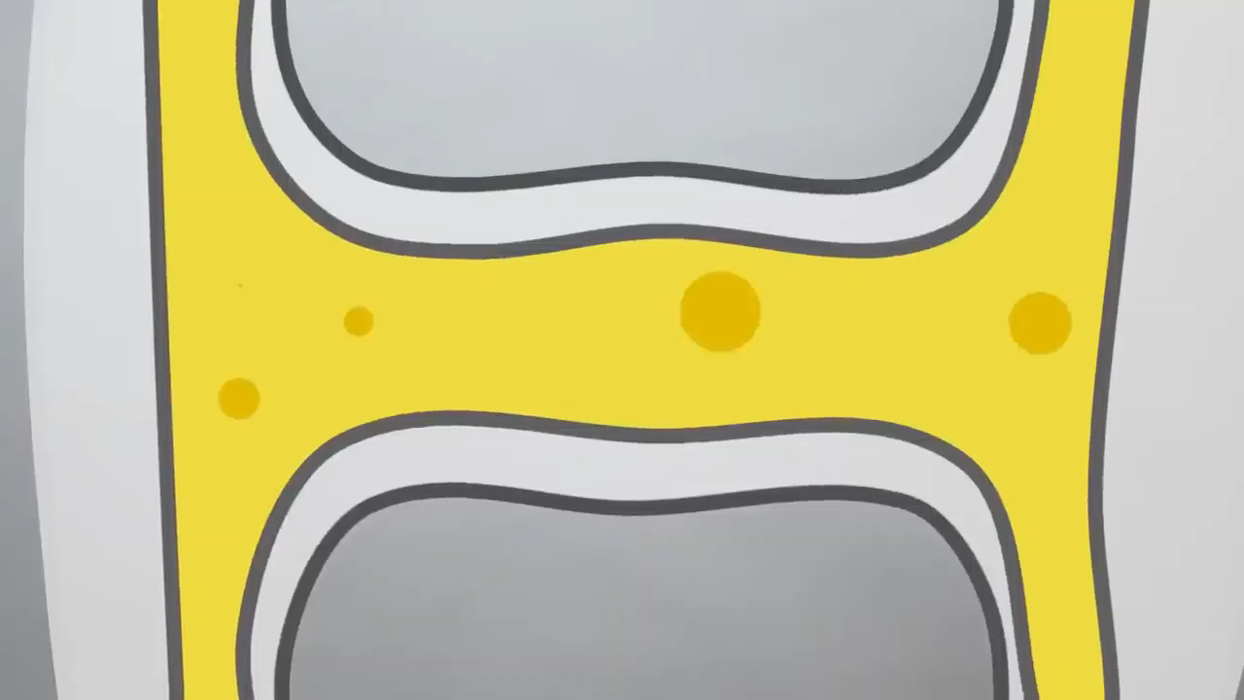

What sound do we hear when a bubble bursts?
Bubble vibration resonance
Bubble bursting
Explanation of the fact
Theoretical model
Experiment
Conclusion
https://sci-hub.se/https://doi.org/10.1119/1.4917442
Notes:
Everything has its own free oscillation frequency, in addition, in our case the frequency of external force acts on the bubble, which is caused by the oscillation of the bones. An event in which an external force frequency approaches a free frequency is called a resonant frequency. At a certain frequency the bubble reaches its maximum size, it bursts and exactly produced a sound of this frequency.

Slide 6
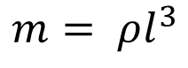
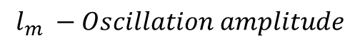
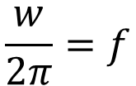
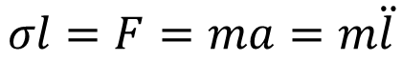
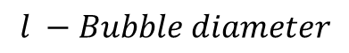
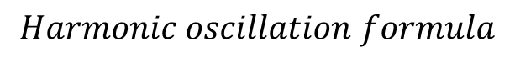
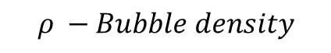
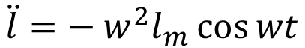
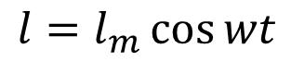
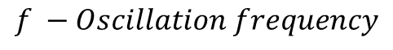
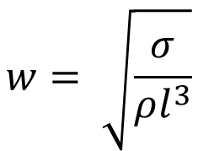
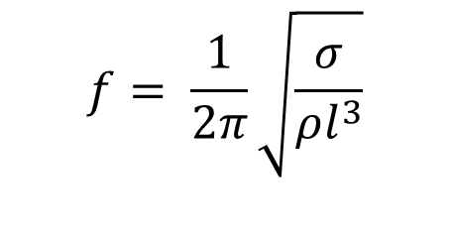
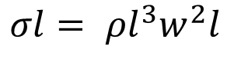
Theoretical model
$$Harmonic oscillation formula$$
$$l −Bubble diameter$$
$$l_{m} −Oscillation amplitude$$
$$l=l_{m}\cos{wt}$$
$$\ddot{l}={− w}^{2}l_{m}\cos{wt}$$
$$w −Circular frequency of oscillation$$
$σ −Surface tension$
$$σl=F=ma=m\ddot{l}$$
$$f −Oscillation frequency$$
$$m= ρl^{3}$$
$$ρ −Bubble density$$
$$σl= ρl^{3}w^{2}l$$
$$w= \sqrt{\frac{σ}{ρl^{3}}}$$
$$f= \frac{1}{2π}\sqrt{\frac{σ}{ρl^{3}}}$$
$$\frac{w}{2π}=f$$
Explanation of the fact
Theoretical model
Experiment
Conclusion
Notes:
To calculate the frequency of this sound, I wrote the harmonic oscillation formula, where l – is bubble diameter, l_{m­} – is Oscillation amplitude, w – is Circular frequency. The second derivative of l is acceleration, which is equal to omega square multiplied by l_{m} and by cos omega t. Then I wrote Newton’s second law. I calculated the circular frequency. We know the dependence of the circular frequency on the oscillation frequency. Finally I got the received sound frequency equation.

Slide 7
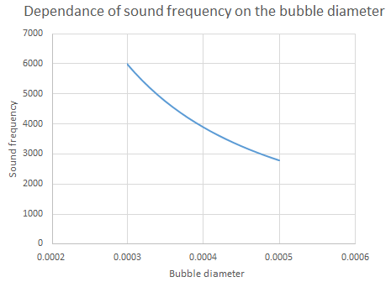
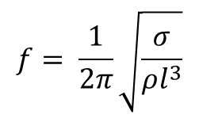
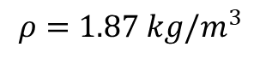
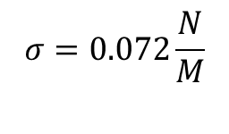
Theoretical graph
$$f= \frac{1}{2π}\sqrt{\frac{σ}{ρl^{3}}}$$
$$σ=0.072\frac{N}{M}$$
$$ρ=1.87 kg/m^{3}$$
Bubble diameter(m)
Explanation of the fact
Theoretical model
Experiment
Conclusion
Notes:
According to this data I built a theoretical graph of the dependence of a bubble diameter on the frequency of sound.

Slide 8
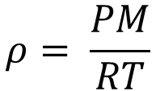
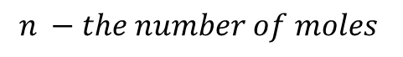
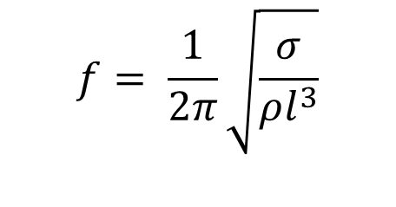
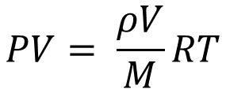
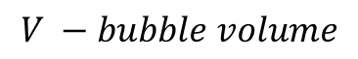
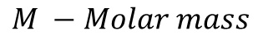
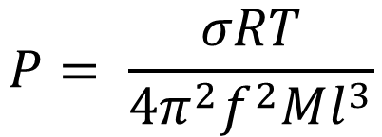
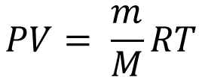
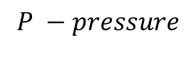
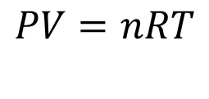
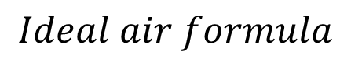
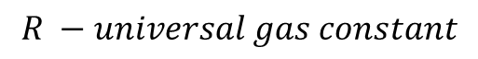
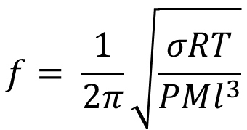
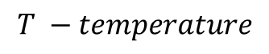
Theoretical model
$$Ideal air formula$$
$$f= \frac{1}{2π}\sqrt{\frac{σ}{ρl^{3}}}$$
$$P −pressure$$
$$PV=nRT$$
$$V −bubble volume$$
$$PV= \frac{m}{M}RT$$
$$n −the number of moles$$
$$f= \frac{1}{2π}\sqrt{\frac{σRT}{PMl^{3}}}$$
$$R −universal gas constant$$
$$PV= \frac{ρV}{M}RT$$
$$T −temperature$$
$$M −Molar mass$$
$$ρ= \frac{PM}{RT}$$
$$P= \frac{σRT}{4π^{2}f^{2}Ml^{3}}$$
Explanation of the fact
Theoretical model
Experiment
Conclusion
Notes:
As we know sound has another characteristic, which is an Amplitude. Sound amplitude is related to the sound pressure. Because of that the sound travels a very long distance to the microphone, it is impossible to take into account all the obstacles (which are the fluid, bones, skin and etc). Since my formula is relative, I figured out which parameter would depend on the sound amplitude. I wrote the ideal air formula. By simplifying the ideal gas formula, I got the density equation, which I put in my first formula and I got the following formula. It became clear that the amplitude of the sound is also related to the diameter of the bubble. From this formula we also received the dependence of sound frequency on the pressure (I built a graph).

Slide 9
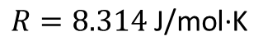
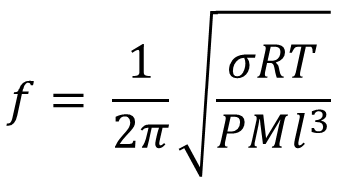
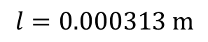
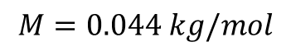
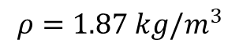
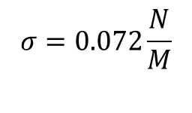
Theoretical graph
$$f= \frac{1}{2π}\sqrt{\frac{σRT}{PMl^{3}}}$$
$$σ=0.072\frac{N}{M}$$
$$ρ=1.87 kg/m^{3}$$
$$M=0.044 kg/mol$$
$$l=0.000313 m$$
$$R=8.314 \text{J}\text{/}\text{mol}\text{·}\text{K}$$
Explanation of the fact
Theoretical model
Experiment
Conclusion

Slide 10
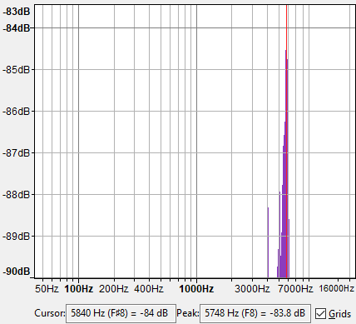
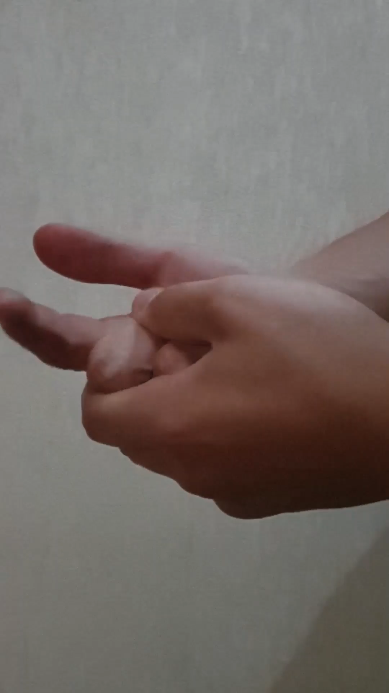
Experiment
Explanation of the fact
Theoretical model
Experiment
Conclusion
Notes:
As for my experiments, I observed the frequency and amplitude of the sound produced by the two types of cracking

Slide 11
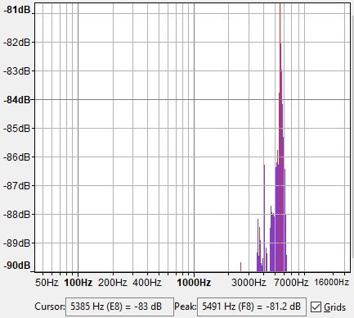
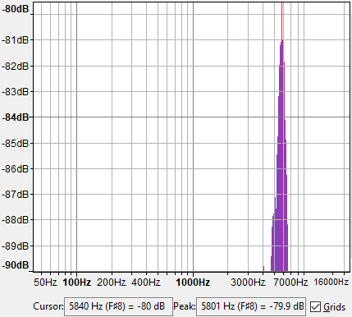
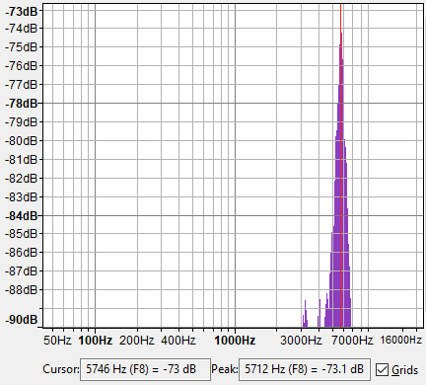



Explanation of the fact
Theoretical model
Experiment
Conclusion
Notes:
During the first types of cracking, I observed changes in frequency and amplitude at different time intervals. The difference between the first and second experiments is 30 minutes, and between second and third experiments was 40 minutes, in next experiments, the interval was increased by 10 minutes, but that did not make much difference between frequencies and amplitudes.

Slide 12






Explanation of the fact
Theoretical model
Experiment
Conclusion
Notes:
I similarly observed the sound frequency and amplitude of the second type of cracking. As you can see neither this time difference is big. These two parameters do not depend on how much time has passed since the first cracking. However, it is noteworthy that in less than 20 minutes from the first cracking, we will not able to crack the finger again.

Slide 13


Conclusion
5491
5801
5712
5499
5748
Experimental frequencies
(Hz)
Average frequency
5650.2 Hz
5482
5682
5499
5946
5504
Experimental frequencies
(Hz)
Average frequency
5622.6 Hz
$$0.000313\left(m\right)≈0.3(mm)$$
Explanation of the fact
Theoretical model
Experiment
Conclusion
Notes:
During the presentation, I conducted experiments on two types of cracking. In the first case, I got an average sound frequency of 5600 hz. In the second case I got 5622 hz. I entered this average frequency into my first formula and I got an average bubble diameter which is 0.3 mm.

Slide 14
Conclusion
$$f= \frac{1}{2π}\sqrt{\frac{σ}{ρl^{3}}}$$
$$f= \frac{1}{2π}\sqrt{\frac{σRT}{PMl^{3}}}$$
Explanation of the fact
Theoretical model
Experiment
Conclusion
Notes:
. I also received a formula from which it is determined that the frequency of sound as well as the amplitude is depend on bubble diameter.

Slide 15
81.2
79.9
73.1
80.8
83.9
Experimental sound amplitude
(db)
Average sound amplitude 79.78 db
Conclusion
84.5
77.8
82.5
82.9
68.2
Experimental sound amplitude
(db)
Average sound amplituden79.18 db
Explanation of the fact
Theoretical model
Experiment
Conclusion

Slide 16
Thanks for your attention!

Slide 17








Theoretical model
$$A= \frac{P}{2πVρf}$$
$$f −Oscillation of frequency$$
$$P=2πfVρA$$
$$V −Velocity of wave in medium$$
$$ρ −Density of medium$$
$$A ≈R$$
$$A −Diplacement amplitude$$
$$P\sim 2πfVρR$$
Explanation of the fact
Theoretical model
Experiment
Conclusion

Slide 18






Theoretical model
$$f= \frac{1}{2π}\sqrt{\frac{σ}{ρl^{3}}}$$
$$Ideal air formula$$
$$P −pressure$$
$$PV=nRT$$
$$V −bubble volume$$
$$f= \frac{1}{2π}\sqrt{\frac{σRT}{PMl^{3}}}$$
$$n −the number of moles$$
$$PV= \frac{m}{M}RT$$
$$R −universal gas constant$$
$$PV= \frac{ρV}{M}RT$$
$$T −temperature$$
$$ρ= \frac{PM}{RT}$$
How to convert sound pressure to amplitude
$$A=20lg⁡(\text{p}\text{/}\text{0.00002}\text{)}$$
Explanation of the fact
Theoretical model
Experiment
Conclusion

